Slide 1
C# Books CRUD
Kiril Shiyan 273222008

Slide 2
Introduction
This application is built to manage database containing books. It allows user to do CRUD operations (create, read, update, delete) on table “Books”. Application uses MySQL for database handling, Entity Framework as ORM, ASP.NET for back-end and React for front-end.

Slide 3
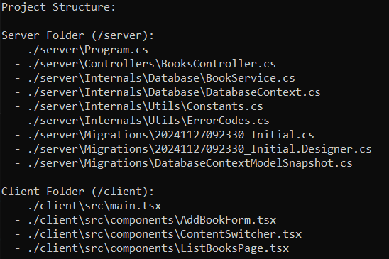
Project Structure

Slide 4
BookController
GET /get-books – Retrieves a list of all books.
GET /get-books-genres – Retrieves a list of all available genres.
POST /add-book – Creates a new book in the database.
POST /update-book – Updates an existing book record.
DELETE /delete-book – Deletes a book record.

Slide 5
BookService
GetBooks() – Retrieves all books from the database.
AddBook(Book book) – Adds a new book to the database.
UpdateBook(Book book) – Updates an existing book record.
DeleteBook(Guid id) – Deletes a book record by GUID.

Slide 6
DbService
modelBuilder.Entity<Book>(entity =>
{
entity.HasKey(x => x.Id);
entity.Property(x => x.Title).HasMaxLength(255).IsRequired();
entity.Property(x => x.Genre).HasMaxLength(30);
entity.Property(x => x.Author).HasMaxLength(255);
entity.Property(x => x.ISBN).HasMaxLength(13);
entity.Property(x => x.Publisher).HasMaxLength(255);
entity.Property(x => x.PublicationDate);
entity.Property(x => x.Language).HasMaxLength(50);
});

Slide 7
Utils
Constants - constants used by application
ErrorCodes - error codes for better error handling

